Slide 1
SQL PROJECT ON PIZZA SALES
BY Mayuri Kakde

Slide 2
HELLO!
My name is Mayuri Kakde In this
project I have Utilize a Sql Queries to
solve a question related to pizza sales

Slide 3
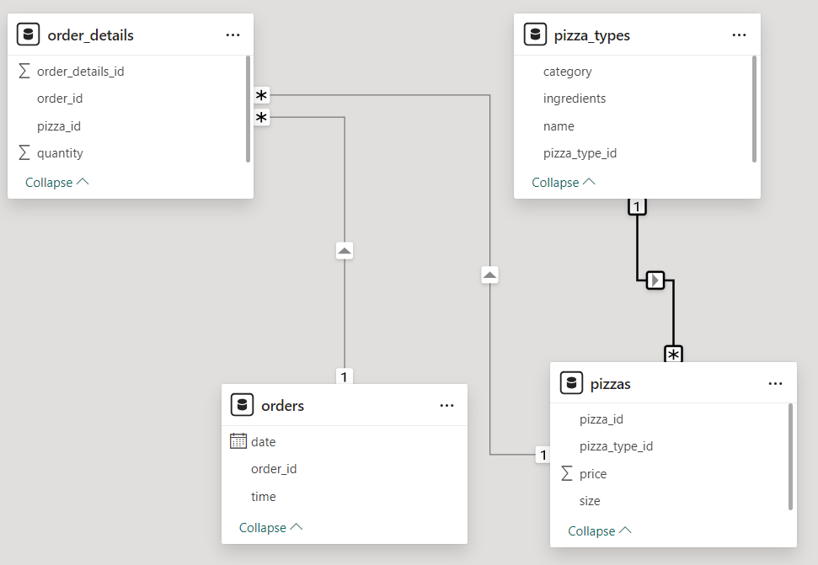
DATA MODEL

Slide 4
QUESTION’S
1.Retrieve the total number of orders placed.
2.Calculate the total revenue generated from pizza sales.
3.Identify the highest-priced pizza.
4.Identify the most common pizza size ordered.
5.List the top 5 most ordered pizza types along With their quantities.
6.Join the necessary tables to find the total quantity of each pizza category ordered.
7. Determine the distribution of orders by hour of the day.
8.Join relevant tables to find the category-wise distribution of pizzas.

Slide 5
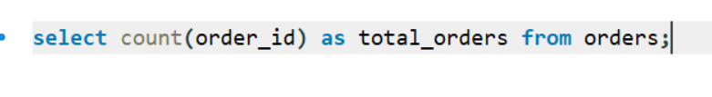
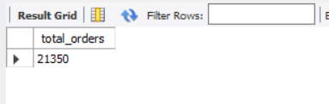
Retrieve the total number of orders placed.

Slide 6
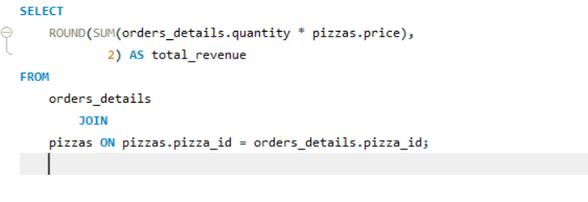
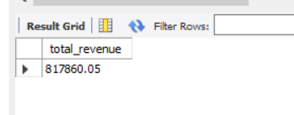
Calculate the total revenue generated from pizza sales.

Slide 7
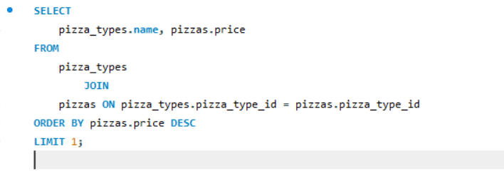
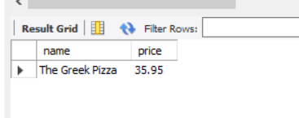
Identify the highest-priced pizza.

Slide 8
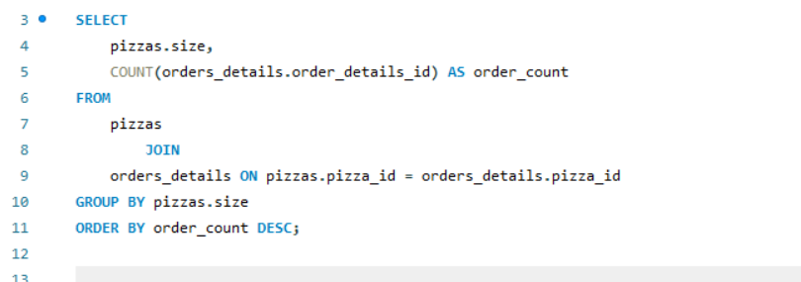
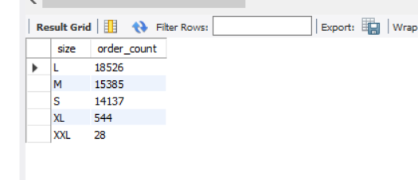
Identify the most common pizza size ordered.

Slide 9
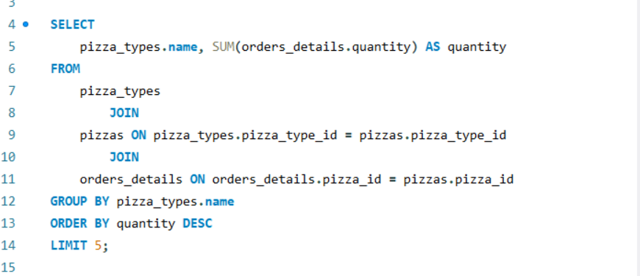
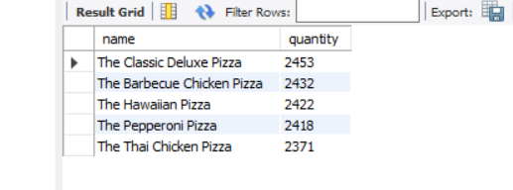
List the top 5 most ordered pizza types along With their quantities.

Slide 10
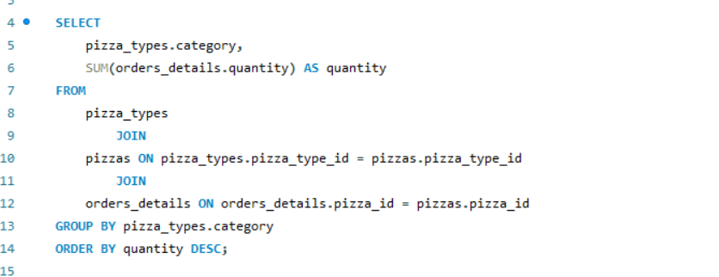
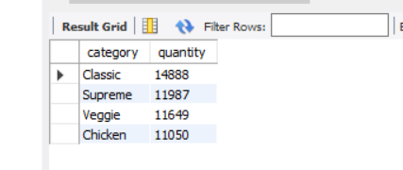
Join the necessary tables to find the total quantity of each pizza category ordered.

Slide 11
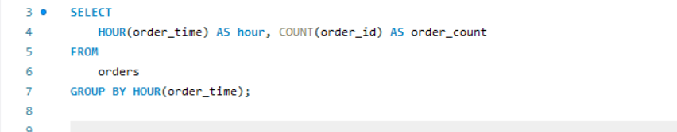
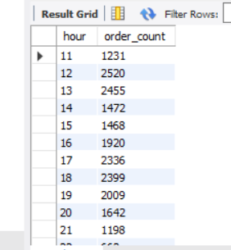
Determine the distribution of orders by hour of the day

Slide 12
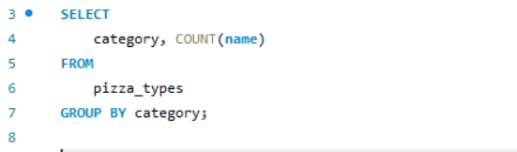
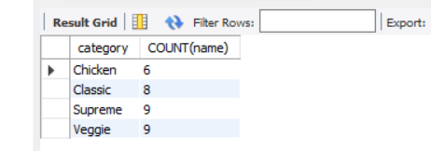
Join relevant tables to find the category-wise distribution of pizzas.

Slide 13
THANK YOU

